Slide 1

AN ANALYSIS TO FOREST FIRE DATA-SET MINI -PROJECT -MEMBERS under The Guidance of Dr. Ditipriya Sinha
Department Of Computer Science & Engineering
National Institute of Technology Patna
1.SANJEEV KUMAR(1406027)
2.RAHUL KUMAR(1406010)
3.ABHISHEK KUMAR(1406004)
4.PRASHANT KUMAR(1406011)

Slide 2
OUTLINE
Introduction
Attribute information
Classes Description
Flow of the work
Clustering
Labelling of Data
Classification
Accuracy and Comparative analysis
Rule Based Classifier
Use cases
Future Work
References

Slide 3
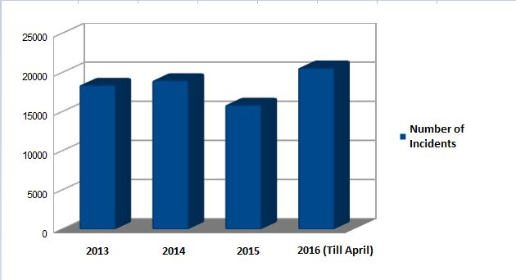
Why Forest Fire? (Introduction)
Increase in number of cases
It becomes important to study
With this we can somehow reduce the burnt area
By deploying or increasing more number of sensor in specific area
It is very important to detect these kinds of fires as early as possible so as to prevent the damage from it to ecological system

Slide 4
Dataset Description
Title | Forest Fire Data Set
Data Set Characteristics: | Multivariate
Number of Instances: | 517
Area: | Physical
Number of Attributes: | 13
Associated Tasks: | Regression

Slide 5
Attribute Information:
1. X - x-axis spatial coordinate within the Montesinho park map: 1 to 9 2. Y - y-axis spatial coordinate within the Montesinho park map: 2 to 9 3. month - month of the year: 'jan' to 'dec' 4. day - day of the week: 'mon' to 'sun' 5. FFMC - FFMC index from the FWI system: 18.7 to 96.20 6. DMC - DMC index from the FWI system: 1.1 to 291.3 7. DC - DC index from the FWI system: 7.9 to 860.6 8. ISI - ISI index from the FWI system: 0.0 to 56.10 9. temp - temperature in Celsius degrees: 2.2 to 33.30 10. RH - relative humidity in %: 15.0 to 100 11. wind - wind speed in km/h: 0.40 to 9.40 12. rain - outside rain in mm/m2 : 0.0 to 6.4 13. area - the burned area of the forest (in ha): 0.00 to 1090.84 (this output variable is very skewed towards 0.0, thus it may make sense to model with the logarithm transform).

Slide 6
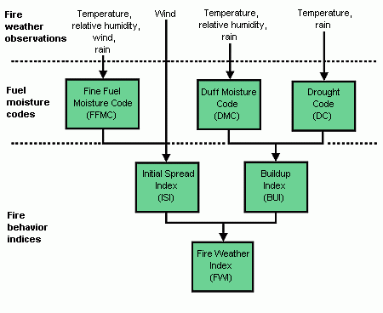
DIAGRAM

Slide 7
Introduction (continues..)
AIM : To classify given dataset into three classes
a) Active Low
b) Active Medium
c) Active High

Slide 8
Classes description:
Active High
It includes the most affected region by fire
Highest number of sensor to be deployed here
Active Medium
It includes the moderate affected region by fire
Lesser number of sensor to be deployed here
Active Low
It includes the least affected region by fire
Very few number of sensor to be deployed here

Slide 9
FLOW DIAGRAM OF OUR WORK:-
DATA COLLECTION
DATA PRE-PROCESSING
CLUSTERING
LABELING THE DATA SHEET
SEGREGATION OF TRAINING AND TESTING DATESET
APPLY CLASSIFICATION TECHNIQUE
FINDING THE ACCURACY
PLOTTING THE GRAPH

Slide 10
Clustering (K-means)
Clustering is a type of Unsupervised learning
This is very often used when you don’t have labeled data
K-Means Clustering is one of the popular clustering algorithm
The goal of this algorithm is to find groups(clusters) in the given data
We have used python libraries (scikit learn) to implement K-means clustering

Slide 11
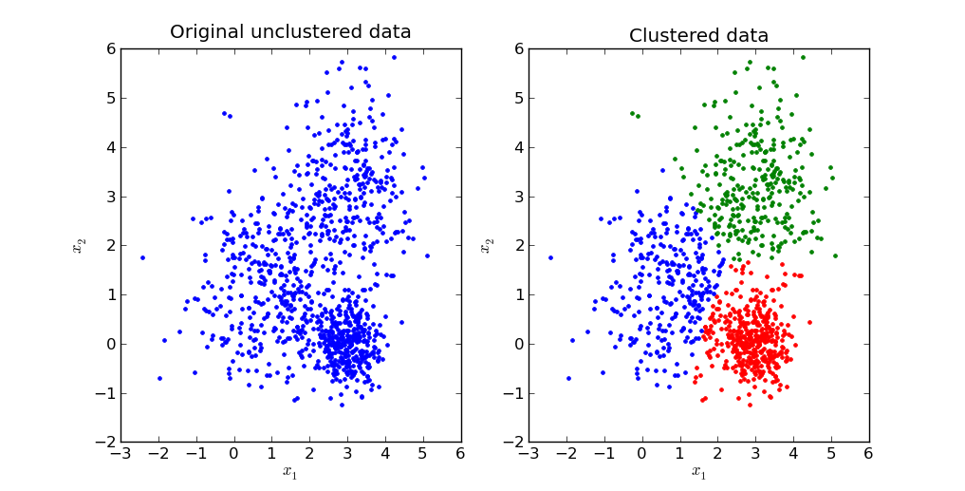
Example

Slide 12
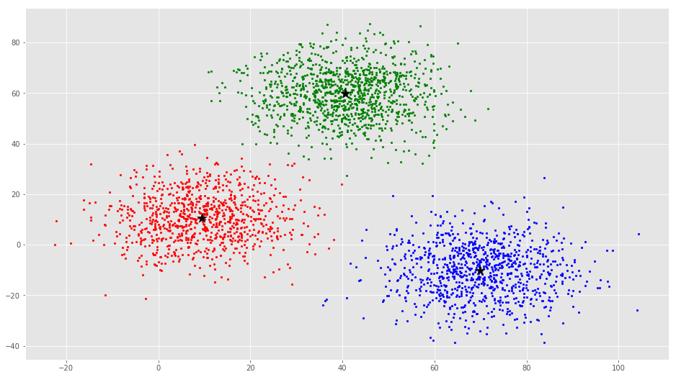
Example (Clusters with centroid)

Slide 13
Labeling of Dataset
We have clustered our dataset into three clusters. Now within each cluster we have to have label each record either as active low or active medium or active high.
For doing this we have analysed our dataset and have done RECURSIVE FEATURE SELECTION.
By doing RECURSIVE FEATURE ANALYSIS we have identified which features plays major role for our dataset analysis.
We have found four features DC,RH, WIND and TEMP have more impact in our analysis.
Using this features we have classify each records within each group as Active low, Active medium and Active high.
We have given threshold values for each group.

Slide 14
Classification
Different models used:
Logistic Regression
Decision Tree
Support Vector Machine(SVM)
Multi-Layer Perceptron

Slide 15
Accuracy (in different models)
Models | Training Accuracy | Testing Accuracy
Logistic Regression | 98.4 | 85.92
Decision Tree | 100 | 92.71
SVM | 100 | 93.2
MLP | 98.6 | 82.52
Testing Dataset:- 361(70%)
Training Dataset:- 155(30%)

Slide 16
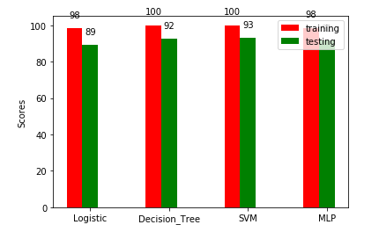
Comparative analysis

Slide 17
Rule Based Classifier
The main reason behind using this classifier is that efficiency is approximately same by using few attributes in comparison of using all attributes.
Thus , it makes energy efficient and provides simplest selection to analyze the problem.
It also reduces the Network Traffic by evaluating the selected attributes.

Slide 18
Models use in Rule Based Classifier
C5 Model
CRT Model
Chaid model
Quest Model
M.Tech Scholar has analyzed all these models and calculated the rules and their accuracy.
Rules generated in each Model

Slide 19
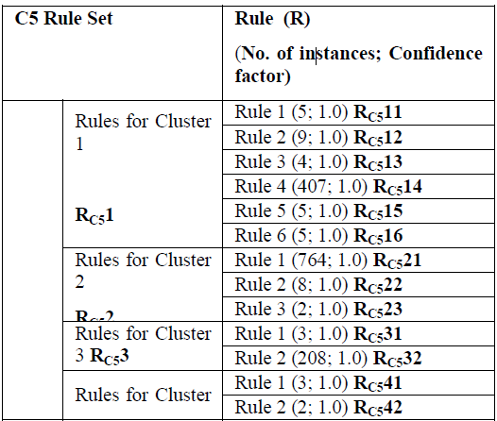
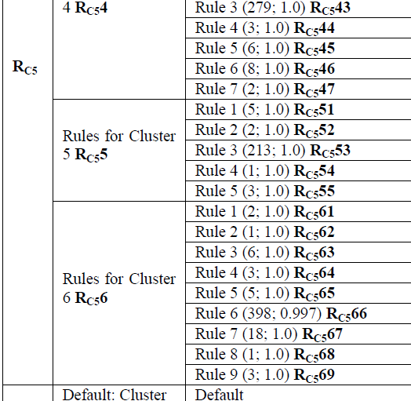
C5 Model

Slide 20
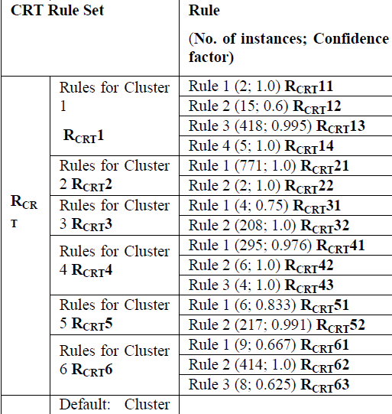
CRT Model

Slide 21
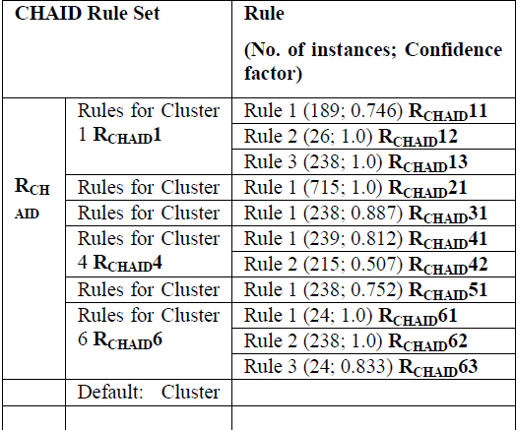
CHAID Model

Slide 22
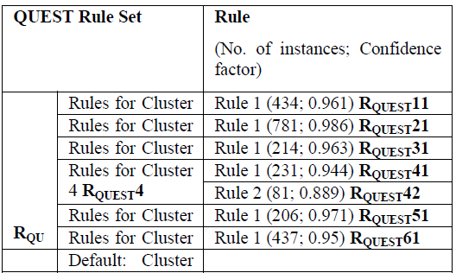
QUEST Model

Slide 23
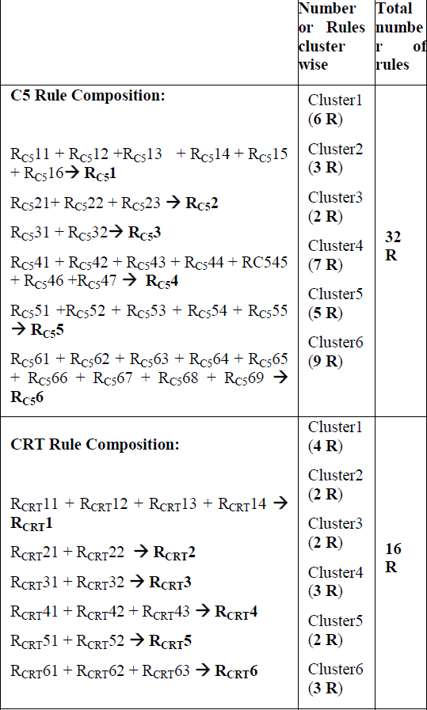
Integrated Model

Slide 24
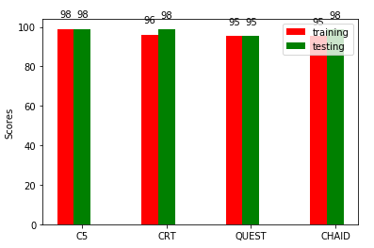
Comparative analysis of each Model
1.Using all features

Slide 25
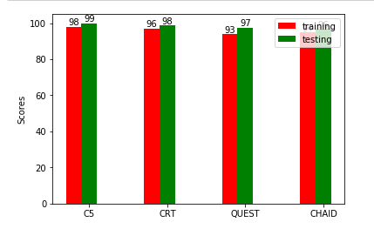
2.Using attributes(DC,RH,TEMP,WIND)

Slide 26
Flow diagram of Integrated model
C5
CRT
CHAID
QUEST
R1
R2
R3
R4
Integrated Model

Slide 27
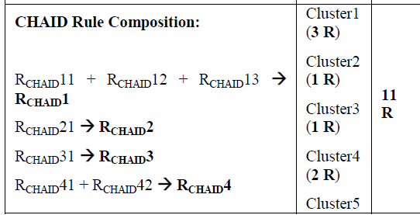
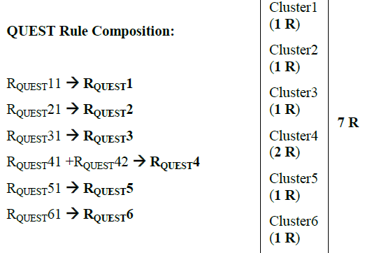
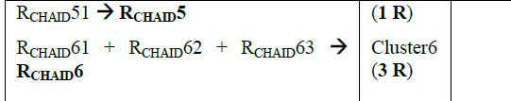
Integrated Model (continues..)

Slide 28
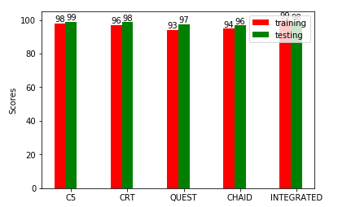
Comparative Analysis of all Models

Slide 29
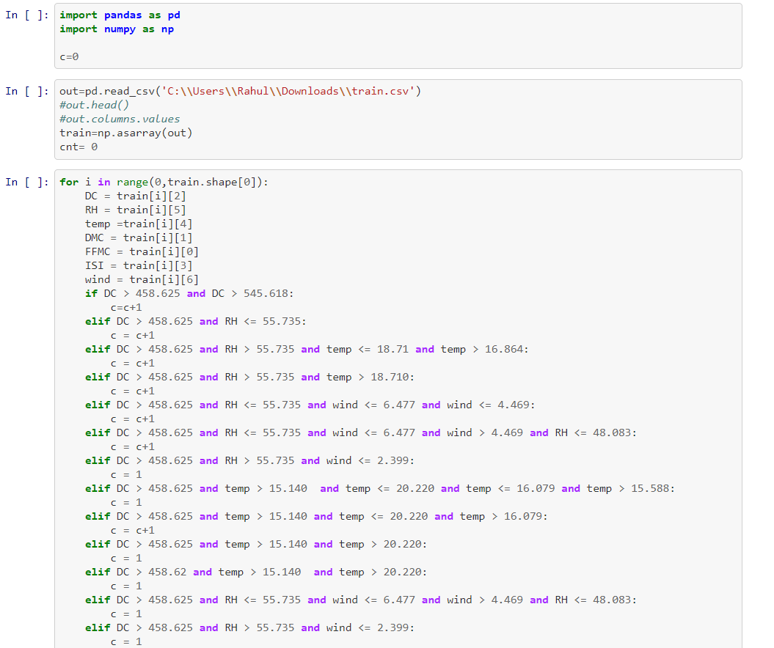
Code Section:

Slide 30
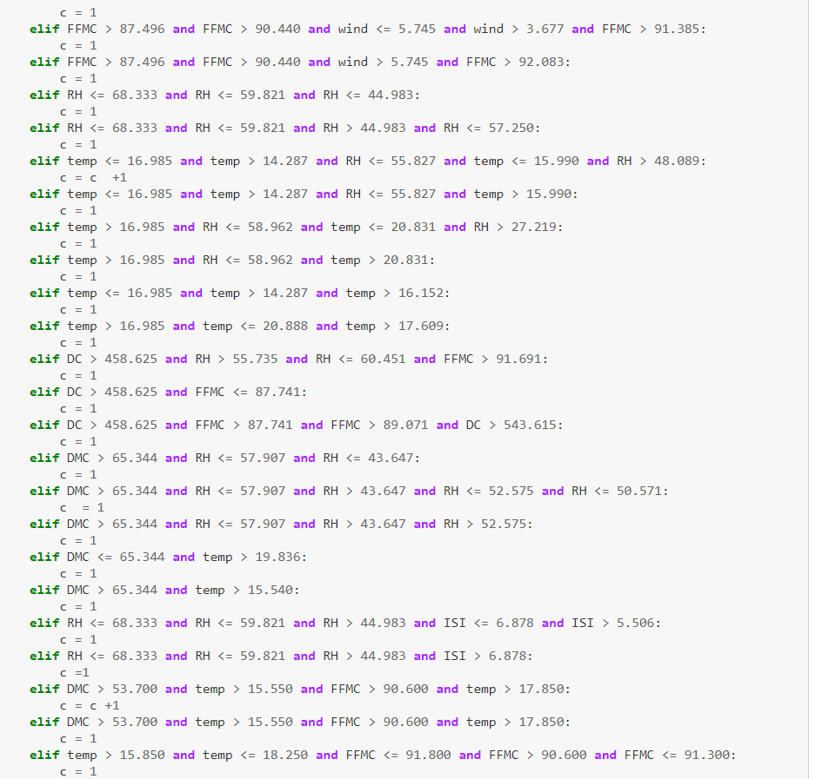
All of the codes are present on Github:
https://github.com/puperfused/Forest-Fire-Dataset

Slide 31
Use cases:
Using the model so designed for use in routing protocol.
Helps in early alerting system to the organization.
Reducing the area being affected by fire.

Slide 32
Future Work
Using this model in Routing protocol.
Design of model that requires minimum number of sensors for maximum coverage.

Slide 33
References
https://archive.ics.uci.edu/ml
http://www3.dsi.uminho.pt/pcortez/forestfires/
https://machinelearningmastery.com/
https://mubaris.com/2017/10/01/kmeans-clustering-in-python
https://www.kaggle.com/datasets
http://scikit-learn.org/stable/

Slide 34
THANK YOU

